Slide 1
Performance Appraisal Training
May 13, 2019

Slide 2
Changes to Performance Appraisal System
Incorporating many best practices such as:
Holistic 30-day process including:
Employee Self Appraisal – 7 Days
Immediate Supervisory Review – 7 Days
Next Level Supervisory Review, if applicable – 7 Days
HR Approval – 3 Days
Final Discussion/Presentation of Appraisal – 6 Days
Finally Executed Appraisals are due in HR @5pm 7/1/19

Slide 3
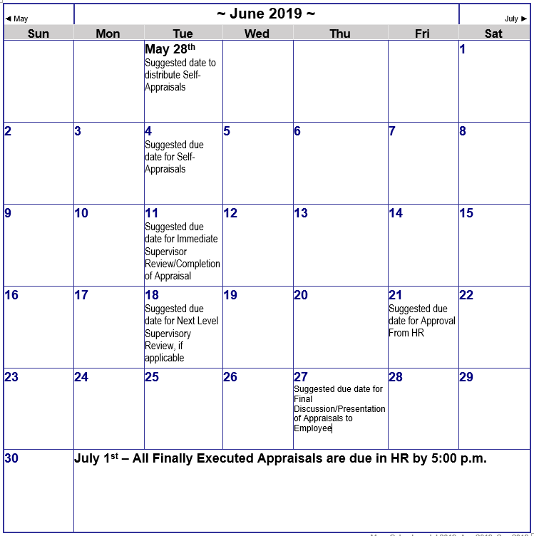

Slide 4
Changes to Performance Appraisal System
Due dates moving
This year (FY19) is a transitional year
Appraising Goals from Previous Evaluation
Setting Goals for FY20
Separation of Appraisal and salary increase decisions
Increases will still be determined during the budget process

Slide 5
Changing from 3 tiered Evaluation to 5 tiered Appraisal
Below Expectations
Consistently Fails to meet expectations
Improvement Needed
Inconsistent – Performance at times meets and at times fails to meet expectations
Meets Expectations
Consistently Solid Performer
Exceeds Expectations
Consistently demonstrates high-level performance
Outstanding/Leader
Consistently demonstrates the highest level performance/exemplifies
work ethic in a variety of assignments

Slide 6
Changes to Performance Appraisal System
Staff divided into three categories
Non-supervisory
Supervisory & Professional
Managerial & Executive
Performance Appraisals will be available in Fillable PDF versions
New Narrative flow of appraisal is logical and more user friendly

Slide 7
Changes to Performance Appraisal System
Five Rating Areas 38-39 Criteria
Understanding
(Job Knowledge, Competence, and Expertise)
Teamwork
(Relational Skills and Effectiveness)
Innovation
(Critical Thinking, Problem Solving, Initiative and Results Orientation)
Conscientiousness
(Awareness and efficient use of Resources and Safety Measures)
Service
(Customer Focus)

Slide 8
Changes to Performance Appraisal System
Professional Goals Section
Goals Must be S.M.A.R.T.
Specific
Measurable
Achievable
Relevant
Time-bound

Slide 9
Training Schedule
May 9 ,2019 – 2:00 p.m. Directors
May 13, 2019 – 1:30 p.m. Managers/Supervisors Immediately following Staff Meeting
May 20, 2019 – 1:30-2:30 p.m. Supplemental

